Slide 1
The Hybrid Encryption with RSA and AES

Slide 2
Review RSA and AES

Slide 3
RSA: How to solve hard math problems?
e . d ≡ 1 mod Φ(n)
Alice or Bob (good guy) can solve the equation (generate the private key) and other people (bad guy like Oscar) are difficult to solve the equation.
Public key
Private key

Slide 4
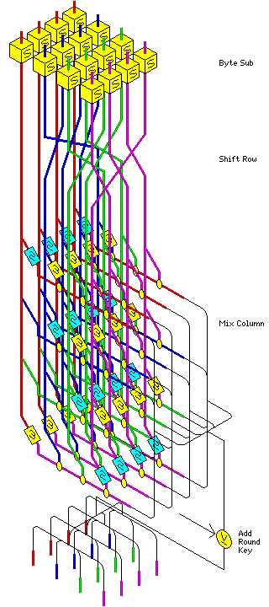
AES: Confusion and diffusion using Math operations
Byte Substitution
Shift row
Mix column
Add around key

Slide 5
Hybrid System

Slide 6
The problem is RSA
Too slow

Slide 7
The main idea of the hybrid system
Encrypt a session key: RSA
Encrypt a document: AES

Slide 8
Scenario: Alice wants to send an encrypted document to Bob
Bob generate a pair of key (public and private)
Bob publish the public key
=================================================
Alice picks a random session key
Alice uses the session key to encrypted document
Alice uses the RSA public-key to encrypt the session key
The encrypted session will be saved to the encrypted doc too
Alice sends the encrypted the doc to Bob
=================================================
Bob will receive encrypted doc
Bob uses AES’s private key to reveal the session key
Bob decrypt encrypted doc using the session key.

Slide 9
Crypt-tool

Slide 10
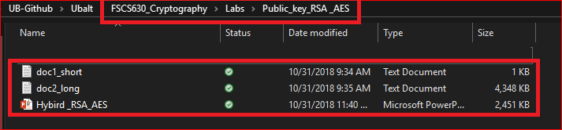
Required files for the lab

Slide 11
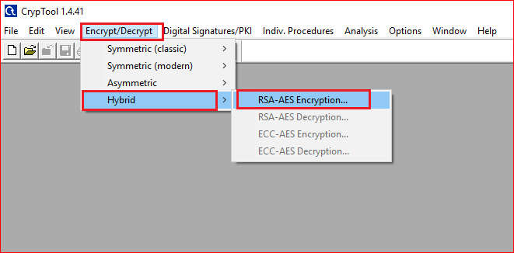

Slide 12
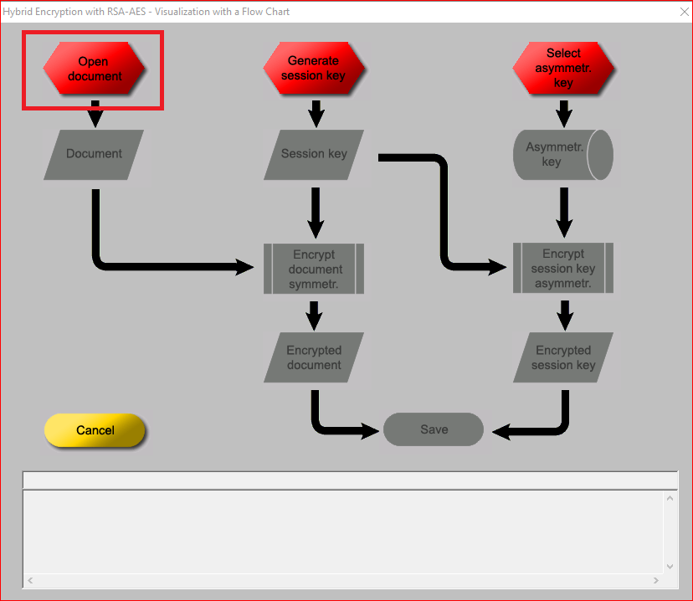
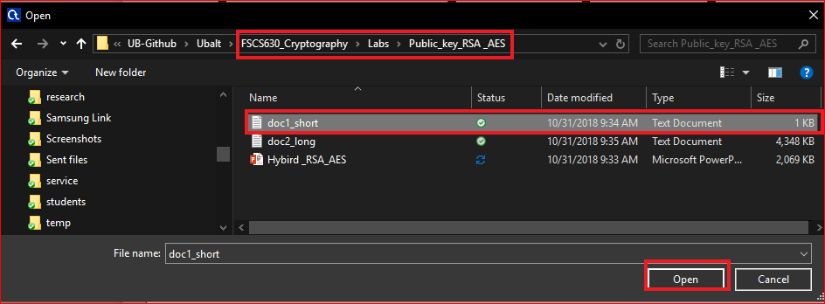

Slide 13
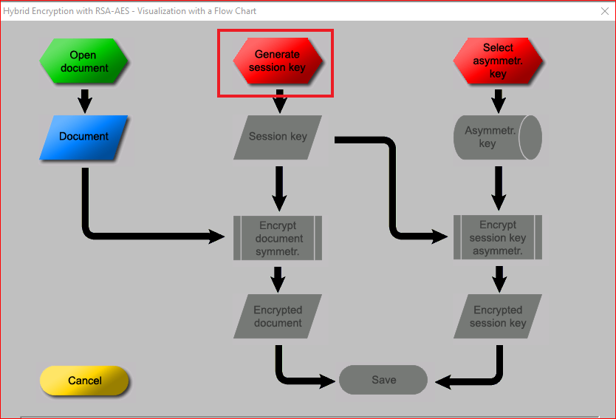
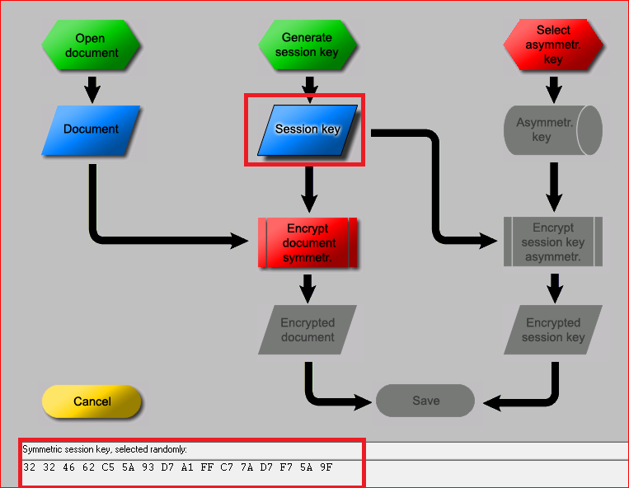

Slide 14
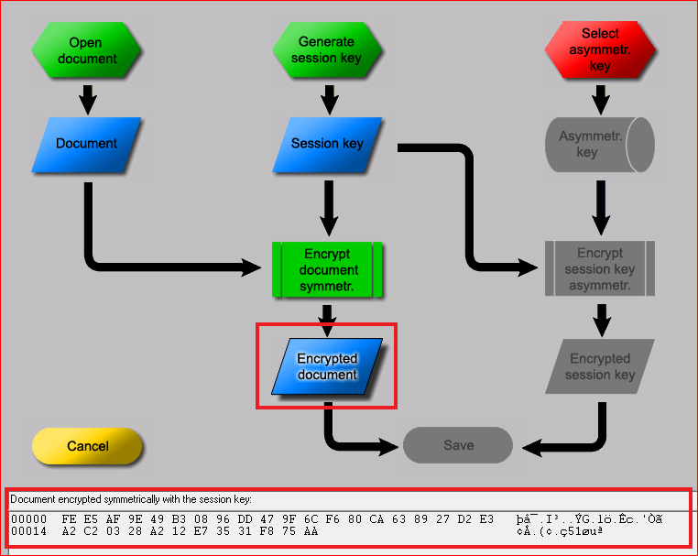
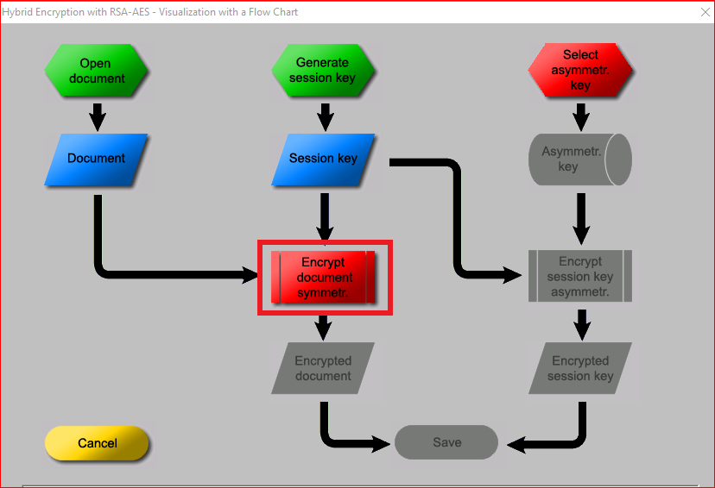

Slide 15
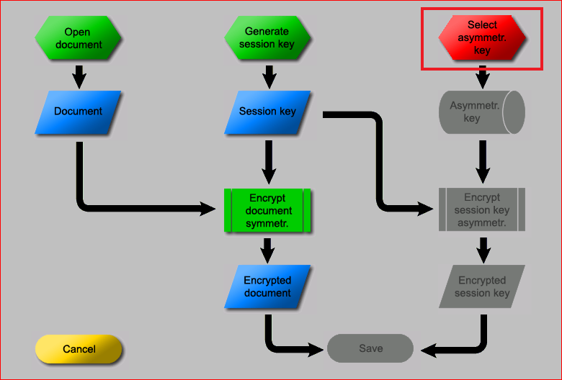
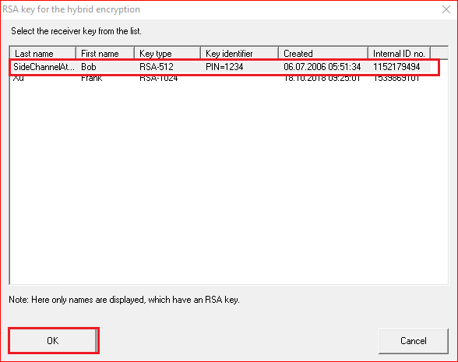

Slide 16
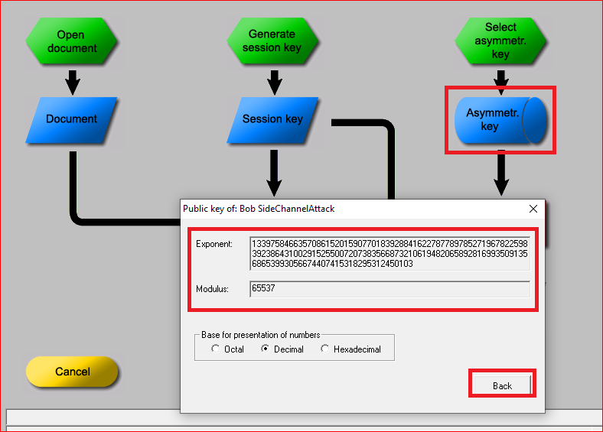

Slide 17
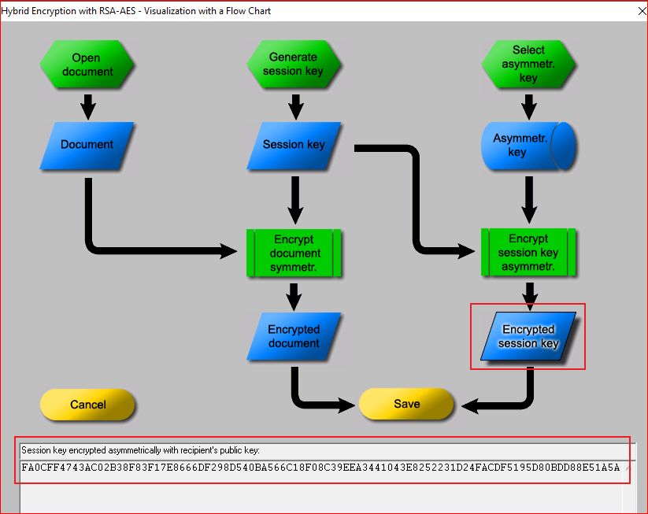
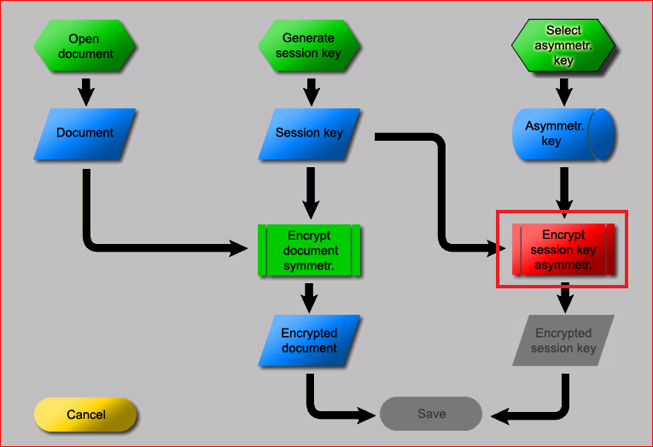
FA0CFF4743AC02B38F83F17E8666DF298D540BA566C18F08C39EEA3441043E8252231D24FACDF5195D80BDD88E51A5A0E9622D0DB26C549769ACBBD3758D9D11

Slide 18
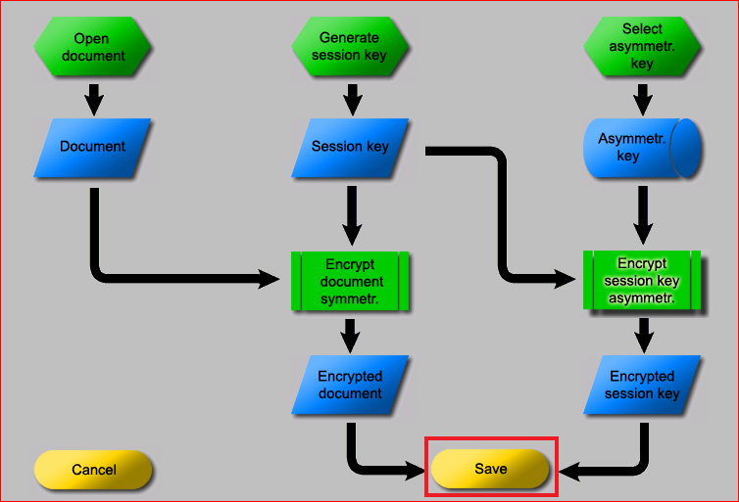
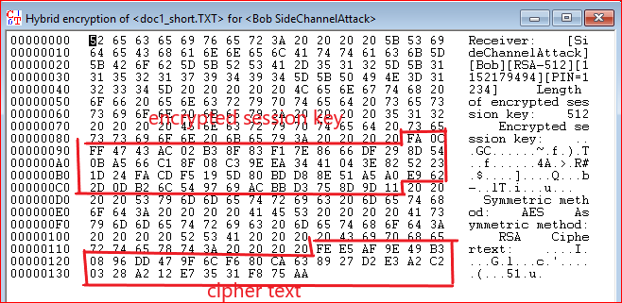

Slide 19
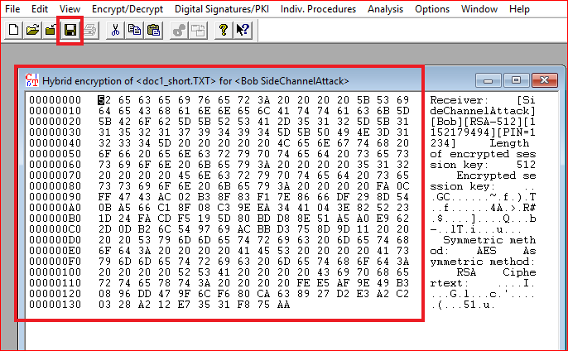
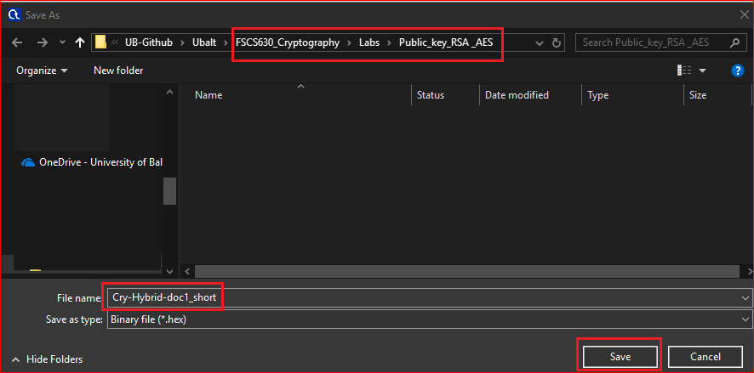

Slide 20
Questions
What is the size of session key in bits?
What is the size of encrypted session key in bits?
What is the size of encrypted text, i.e., “hello RSA and AES”? Why?
What is the size of doc1_short.txt?
What is the size of encrypted file Cry-Hybrid-doc1_short.txt?

Slide 21
Your work
Encrypt the doc2_long.txt
Overserve the file size of the original file and encrypted file. Are they different? Why?

Slide 22
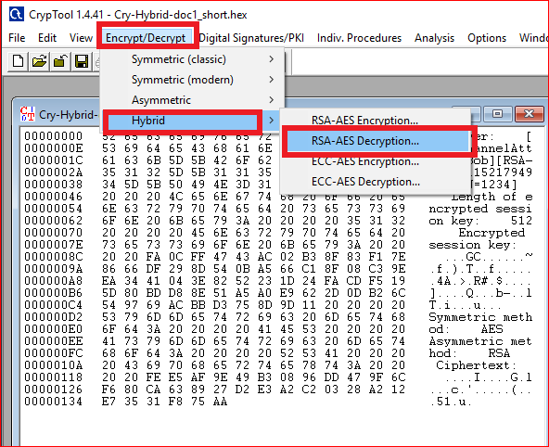
Your work
Decrypt the Cry-Hybrid-do1_short.hex

